Slide 1
Planning courses with ease
(If you don't value time that much)
By Francesco, Harmen, Shu, Thomas, Markos (group 8)

Slide 2
Index
Ontology
Agent architecture
Scenarios
Performance measurement
Discussion

Slide 3
Ontology
Interesting concepts
Faculty/Location
Day parts
Skills
What we can infer
Basics (Ex. Course is subclass of exactly taught on 2 days)
Someone doesn't like a location
Not on a morning
Skills of lecturer (Ex. get courses with the same skills as Pinar Yolum)
Interesting choices
Topic hierarchy by relations (Infer hierarchy)

Slide 4
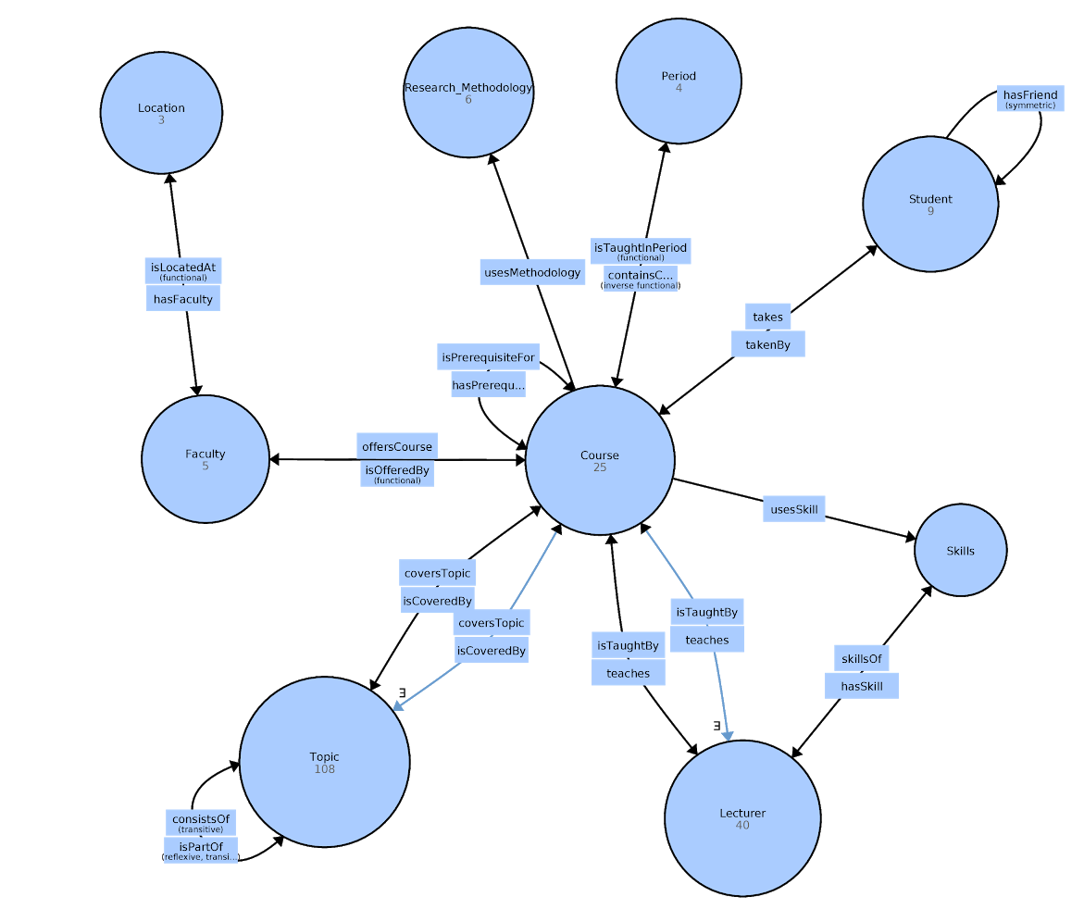
Relations (minimized)

Slide 5
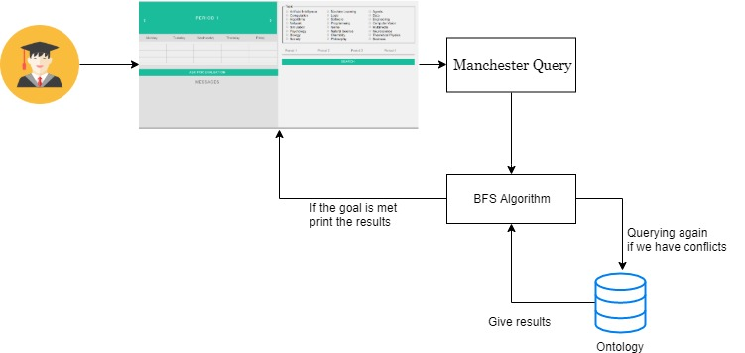
Agent structure - Architecture Graph

Slide 6
Agent structure - Goal based
Goal: To find a minimum of 2 courses for each period which respect most of user-preferences
We will use the breadth first search (BFS) algorithm
Generate all possible children nodes
Place them on a queue until a state is found in which the goal is reached.
The stopping rule: checks the current state(=node) by sending the corresponding query to the ontology
If the goal is met then we stop the process and print the results
If the agent finds a goal, it is always the shortest action-sequence to the goal

Slide 7
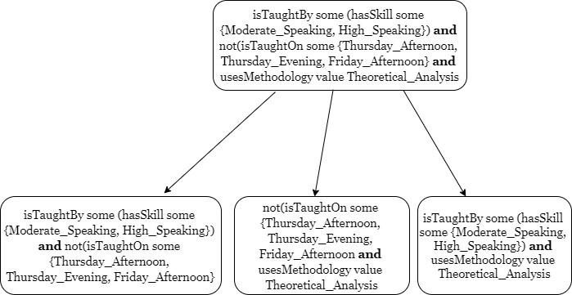
Breadth first search - Example
Notes:
Why breadth first search?
So on the parent node we don’t know what is causing the conflict. We could have stop here and just print that there is no result based on the stated preferences but we thought it would be better to give at least some suggestion from the parts of the query that is not causing the problem.
Check in each node if we found at least 2 courses with no conflict, then this is our goal.
If we have conflicts we separate the initial query in smaller parts taking all possible combination.
When we say that we have conflicts it means that, in this case, there is no course that isTaughtBy some (hasSkill some {Moderate_Speaking, High_Speaking}) and is not tought on {Thursday_Afternoon, Thursday_Evening, Friday_Afternoon}

Slide 8
Scenario
“Josè Carrillo is an international student who has just arrived at UU for his master degree and he is looking for courses for year 1. Since he is not used to the language yet, he wants to take courses only from lecturers with at least moderate talking skills, to be sure to properly understand all the lectures.
All periods:
isTaughtInPeriod value Period_1 and isTaughtBy some (hasSkill some {Moderate_Speaking, High_Speaking})

Slide 9
Scenario
Besides this, he wants to take a course from H.M. Huistra, since she went to Josè’s bachelor university for a conference and Josè appreciated it so much to decide to come to Utrecht for his master.
All periods:
isTaughtBy value H_M_Huistra

Slide 10
Scenario
To pay for his studies Josè is going to work during the winter: he has already found a part-time job in the afternoon on Wednesdays and Thursdays. Due to that, his courses must not be taught in period 2 and period 3.
Period 2 and period 3:
not(isTaughtOn some {Wednesday_Afternoon, Wednesday_Evening, Thursday_Afternoon, Thursday_Evening})

Slide 11
Scenario
Josè has understood that in the summer the Wilhelmina-park is full with students enjoying the sun with beers and wines. Therefore he only wants to follow courses on Thursday and Friday mornings, later these days he is going to the park with his friends. On Monday, Tuesday and Wednesday he is available the whole day.
Period 4:
not(isTaughtOn some {Thursday_Afternoon, Thursday_Evening, Friday_Afternoon, Friday_Evening})

Slide 12
Scenario
His goal is to do a PHD in Logics, so he is mainly interested in a theoretical approach to research, in order to explore all the existing literature and gain a wide knowledge of the fundamental milestones of every field. Therefore he wants to take some courses that cover Logic Topics. Moreover, he doesn’t want to follow any philosophy courses, since he is bad at it.
All periods:
coversTopic some(isPartOf value Logic_Topic) and not (coversTopic some (isPartOf value Philosophy_Topic))

Slide 13
Scenario
He is a very theoretical person: he prefers doing written exams, where he takes better grades with respect to other forms of evaluation
All periods:
hasExamForm value Written_Exam

Slide 14
Combine preferences
Period 3:
isTaughtInPeriod value Period_3 and isTaughtBy some (hasSkill some {Moderate_Speaking, High_Speaking}) and isTaughtBy value H_M_Huistra and usesMethodology value Theoretical_Analysis and hasExamForm value Written_Exam and not(isTaughtOn some {Wednesday_Afternoon, Wednesday_Evening, Thursday_Afternoon, Thursday_Evening}) and coversTopic some(isPartOf value Logic_Topic) and not (coversTopic some (isPartOf value Philosophy_Topic))

Slide 15
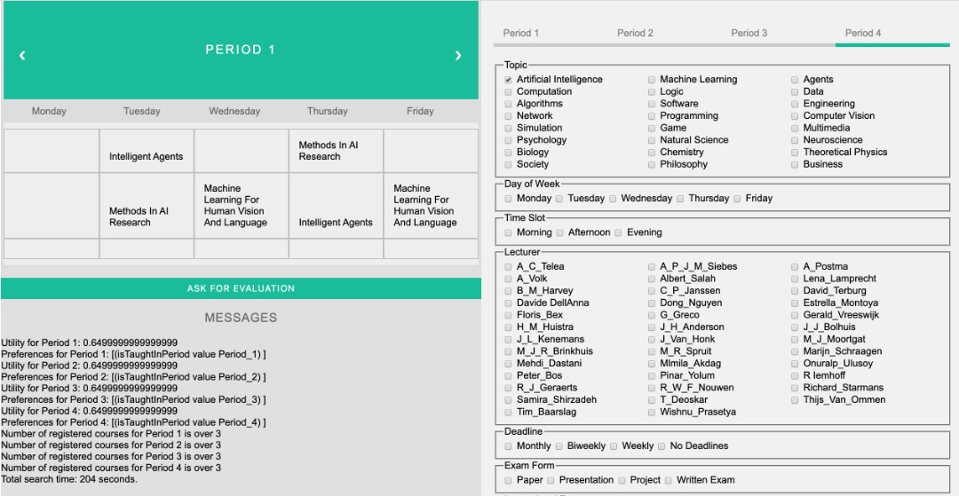
(Running) example

Slide 16
Performance
Functional Performances
Precision =( Corrects + 1/2 Partials)/(Corrects + Partials + Incorrect)
Recall = Accepted/ (Accepted + Refused)
Accuracy = (Corrects + 1/2 Partials +Accepted)/ ( Corrects + Partials + Incorrects +Accepted + Refused)
Non functional Performances
Time of response (below 2 seconds)
Expressivity

Slide 17
Discussion
A working goal based agent
Study curriculum planner domain
Using a Breadth First Search algorithm
Tested on five fictive scenarios → each consumes >5 minutes
Therefore cannot be used in reality

Slide 18
Discussion
Time consumption
BFS search for every period
Every BFS tree for every period
Ontology query for every node
Time-slot conflict checks
Depth limited search?
Designing an ontology that makes more use of the reasoners capabilities
Method that adds students knowledge (preferences) to the ontology.
Weighted preferences → Utility function (Utility Based Agent)
Opportunities for new faster search techniques that find (local/global) optimum

